Slide 1
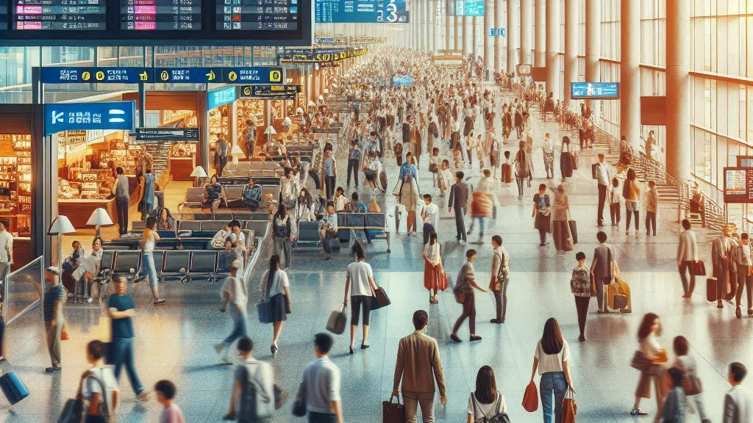
Reducing Flight Delays with AI: Optimizing Schedules for Reliable Air Travel
Name: Hieu Nguyen

Slide 2
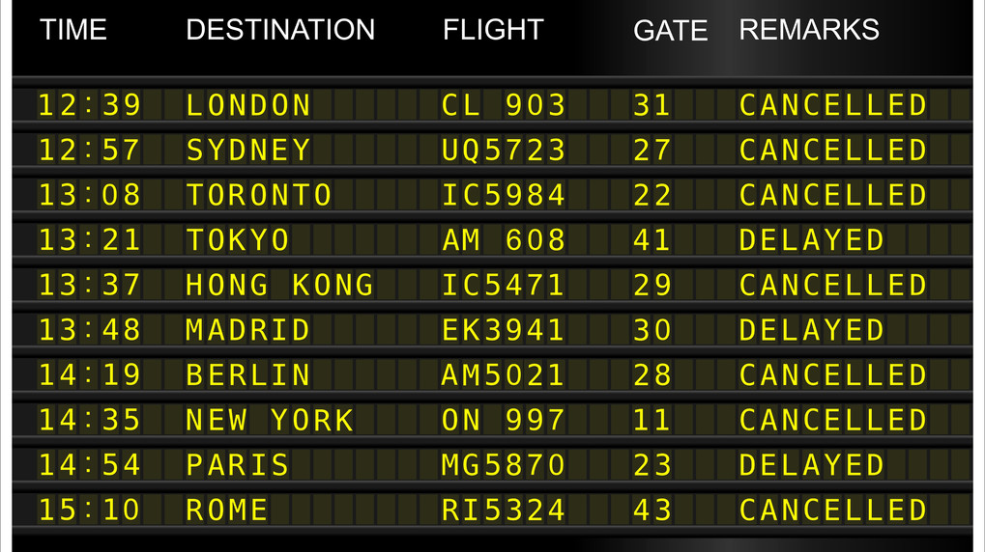
Introduction:
Flight delays are a significant issue in the aviation industry, affecting millions of passengers every year. These delays not only lead to frustration and inconvenience for passengers but also cause significant financial losses for airlines.
The economic impact of flight delays is substantial, with airlines incurring increased operational costs, including fuel, crew, and compensation expenses.
In this project, I will explore how Artificial Intelligence (AI) can be used to optimize flight schedules and reduce delays, ultimately improving the reliability and efficiency of air travel.

Slide 3
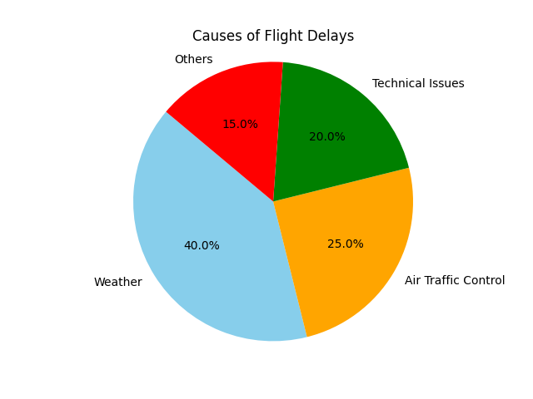
Problem Statement:
Flight delays can be caused by various factors, including adverse weather conditions, technical malfunctions, and inefficiencies in air traffic control systems.
Weather-related delays are among the most common, accounting for approximately 40% of all delays. Other significant causes include air traffic control delays (25%) and technical issues (20%).
According to the Bureau of Transportation Statistics, nearly 20% of flights in the United States are delayed each year, leading to an estimated annual loss of $8 billion for U.S. airlines.
These delays also result in missed connections, disrupted travel plans, and diminished passenger satisfaction, highlighting the need for a more effective solution.

Slide 4
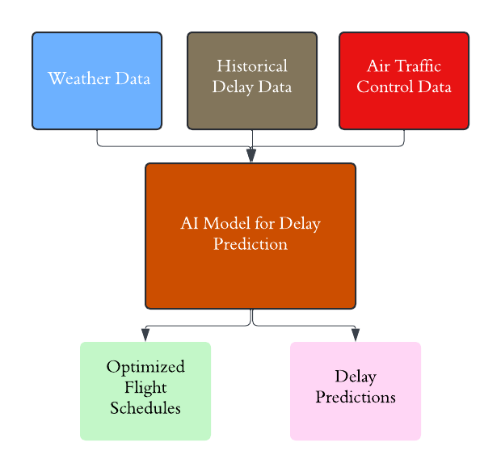
Proposed AI Solution
Artificial Intelligence (AI) can help predict and mitigate flight delays by analyzing patterns in historical data, real-time weather conditions, and air traffic information.
Machine learning models can identify correlations and forecast delays before they occur, allowing airlines to adjust schedules proactively.

Slide 5
AI Technology:
The solution will leverage advanced machine learning techniques, such as predictive analytics and deep learning, to analyze large datasets and identify patterns that could lead to delays.
Predictive analytics involves using historical data to forecast future outcomes. In this context, it can predict flight delays based on past trends in weather, air traffic, and other relevant factors.
Natural Language Processing (NLP) will be used to analyze unstructured text data from pilot reports, maintenance logs, and even passenger feedback to identify potential issues that could cause delays.
The AI models will be continuously trained and updated with new data to improve their accuracy and adapt to changing conditions.

Slide 6
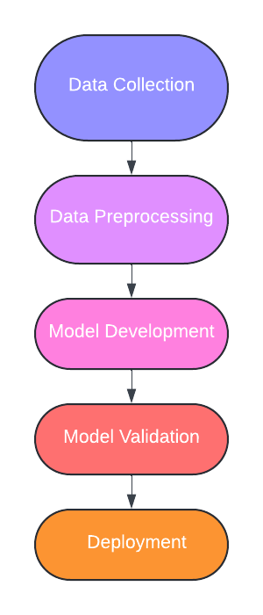
Implementation Plan
Data Collection: "Gather data from various sources, including historical flight records, real-time weather data, and air traffic control information.“
Data Preprocessing: "Clean and preprocess the data to ensure accuracy and consistency.“
Model Development: "Develop machine learning models using the preprocessed data.“
Model Validation: "Validate the models with a separate dataset to ensure accurate predictions.“
Deployment: "Deploy the validated models into the airline’s operational systems."

Slide 7
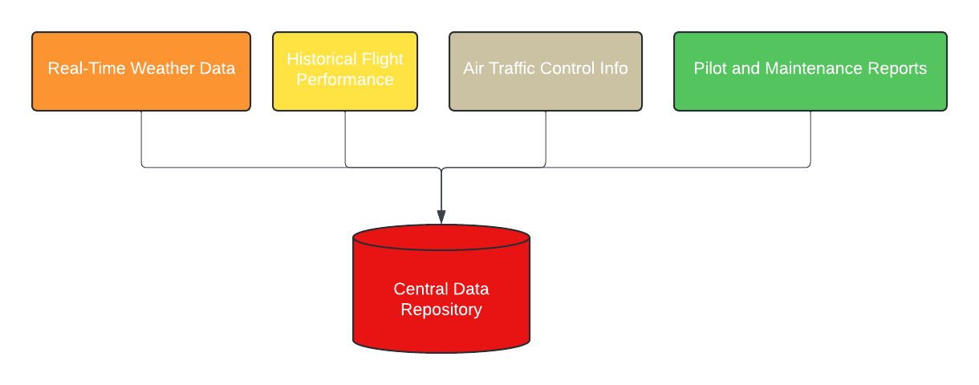
Data Requirements

Slide 8
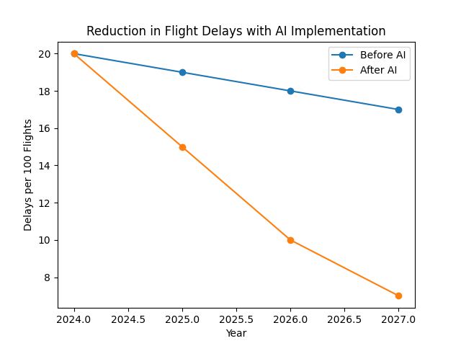
Expected Outcomes with a line graph showing delay reduction:
The AI solution is expected to reduce flight delays by 30%, improve on-time performance, and increase passenger satisfaction.
Success will be measured through metrics such as the reduction in average delay time and improvements in customer satisfaction scores.

Slide 9
Challenges and Limitations
Data Quality: "Ensuring the accuracy and completeness of the data is critical for model performance."
Data Integration: "Integrating data from various sources can be complex and time-consuming."
Model Bias: "There is a risk of model bias if the training data is not representative of all scenarios."
Ethical Considerations: "Using real-time data raises privacy concerns, which must be managed carefully."
Cost and Resource Constraints: "Developing and maintaining an AI solution requires significant investment in technology and skilled personnel."

Slide 10
Conclusion
Flight delays are a complex issue, but AI offers a promising solution to predict and prevent them.
By leveraging AI, airlines can improve the reliability of air travel, reduce operational costs, and enhance passenger satisfaction.
The successful implementation of this solution could revolutionize how airlines manage flight schedules, leading to a more efficient and reliable travel experience.

Slide 11
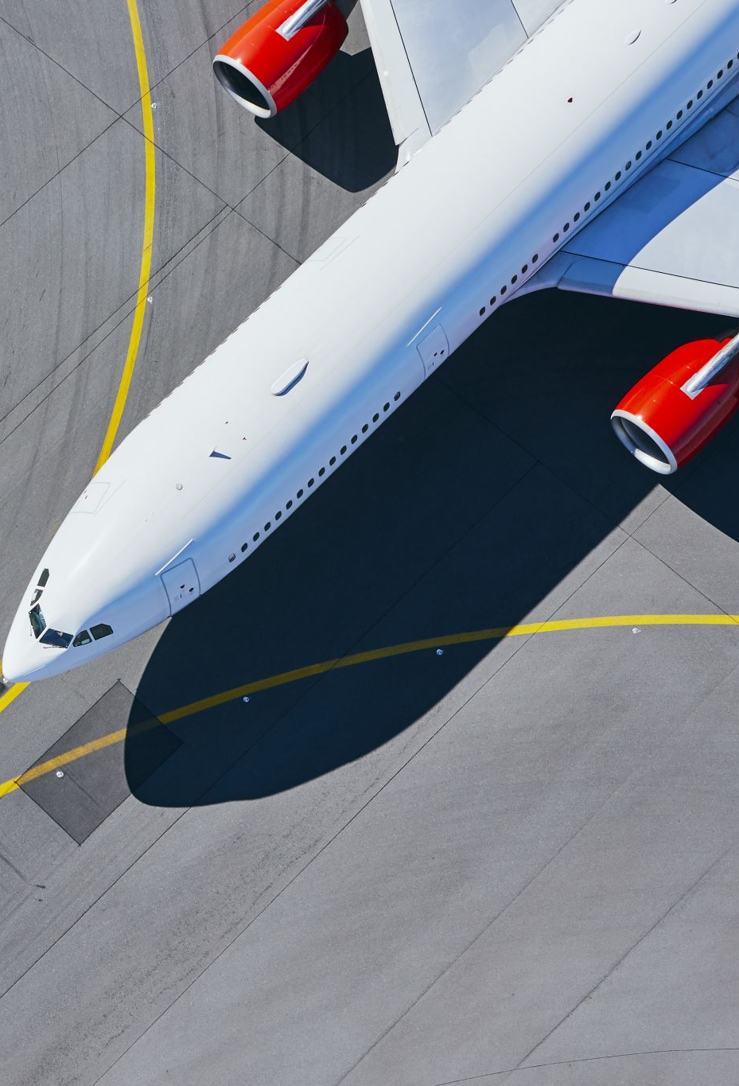
References
Bureau of Transportation Statistics. (2024). Airline On-Time Statistics and Delay Causes. U.S. Department of Transportation.
Hall, E. (2019). AI in Aviation: The Role of Machine Learning in Predicting and Preventing Delays. Aviation Today.

